Slide 1
Sorting Algorithm - CS404
Trinity McCann, Sam Burns, Emily Henderson

Slide 2

Introduction
Our goal for this project is to create & compare the different time complexities between sorting algorithms.
This presentation is meant to show the comparisons and the findings of said comparison in an organized fashion.
Everything within this project should help solidify the understanding between different sorting algorithms and their purpose.
The sorts chosen will be Merge sort, Bubble sort, & Quick sort.

Slide 3

What is an algorithm & efficiency??
An algorithm is a procedure that is systematically designed to solve computational problems step-by-step.
For it to be effective it must be well-designed & correct. It should be time & space efficient.
Time complexity measures how fast an algorithm runs as the input grows.
Time complexity is shown by using Big-O notation

Slide 4
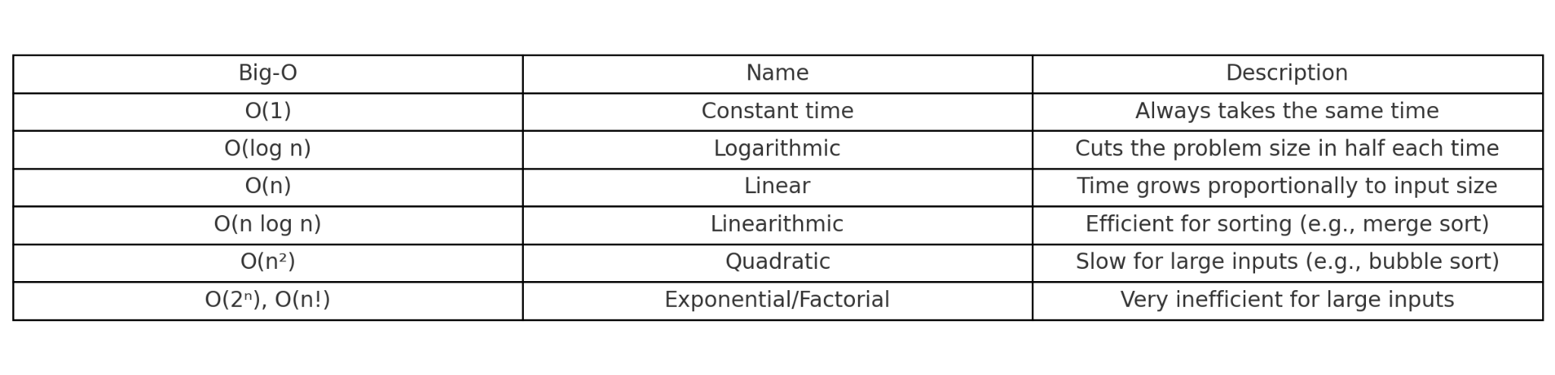
What is an algorithm & efficiency??

Slide 5
What is Quick Sort?
Time Complexity
Worst Case: O(n²)
Average Case: Ө(nlogn)
This makes it one of the fastest sorting algorithms!
Steps
Choose a pivot in the array (often the first or last element)
Partition the array by arranging the elements so that everything lower goes to the left and everything higher goes to the right
Recursively apply these steps to the sub-arrays
Facts: Quick Sort is…
Efficient | Divide & Conquer Approach | In-Place
Unstable | Random | Recursive
Trinity McCann

Slide 6
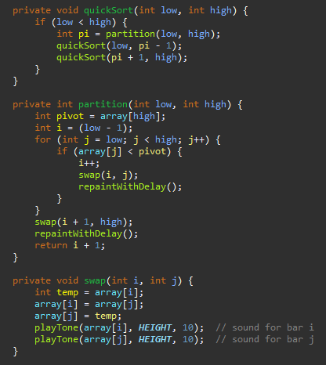
Code for Quick Sort
The code was created on Eclipse using OpenAI’s ChatGPT 4o Model
My Quick Sort implementation has three methods for sorting.
QuickSort
The Main method
Establishes pi which represents the pivot point
Partition
Divide and conquer portion
Sets pivot as the high number
If j is < pivot, runs swap
Swap
Swaps the positions of i and j in the array
Trinity McCann

Slide 7
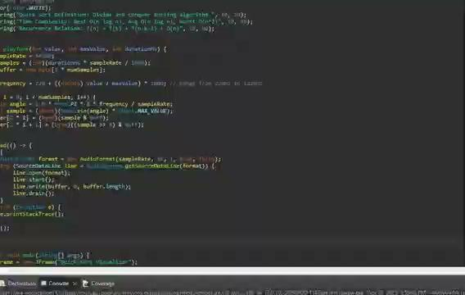

Slide 8
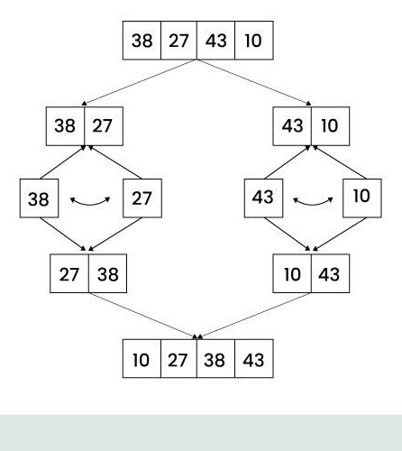
What is Merge Sort?
Time Complexity:
For all cases Merge sort is O(n log n).
Space Complexity O(n)
It scales proportionally to the size of the input multiplied by the logarithm of the size.
Quick steps for Merge:
Split/divide the array into two different halves (Divide)
Recursively sort each half using merge sort (Conquer)
Merge the two halves back together in a single array(Merge)
Image from GeeksforGeeks

Slide 9
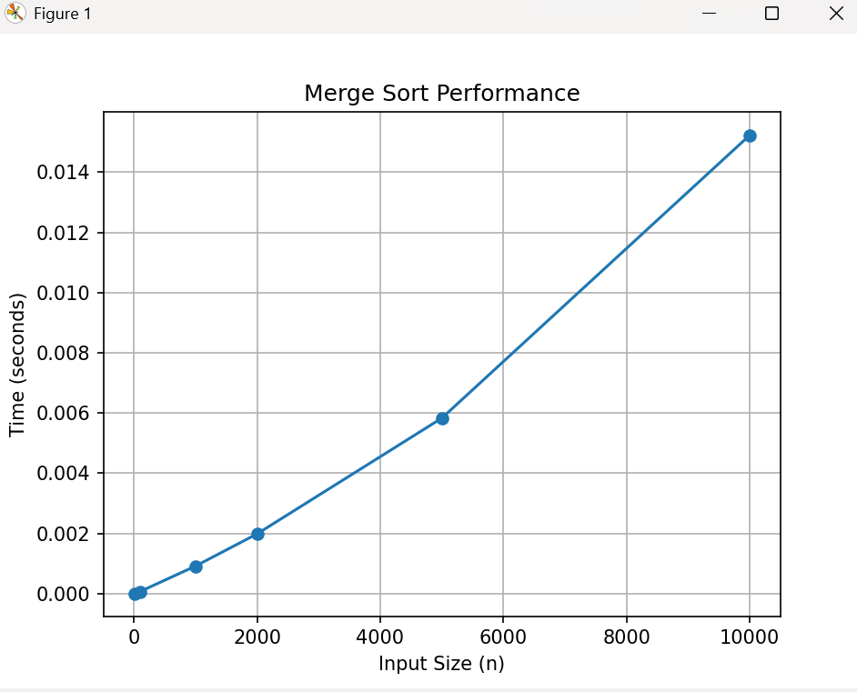
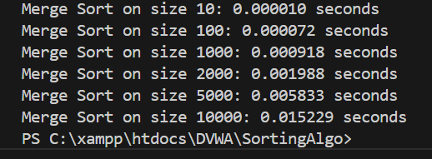
Merge Sort Python
Overall faster
Memory seems to be faster with recursive slicing
Harder to parallelize (Multiple tasks at once) natively.

Slide 10
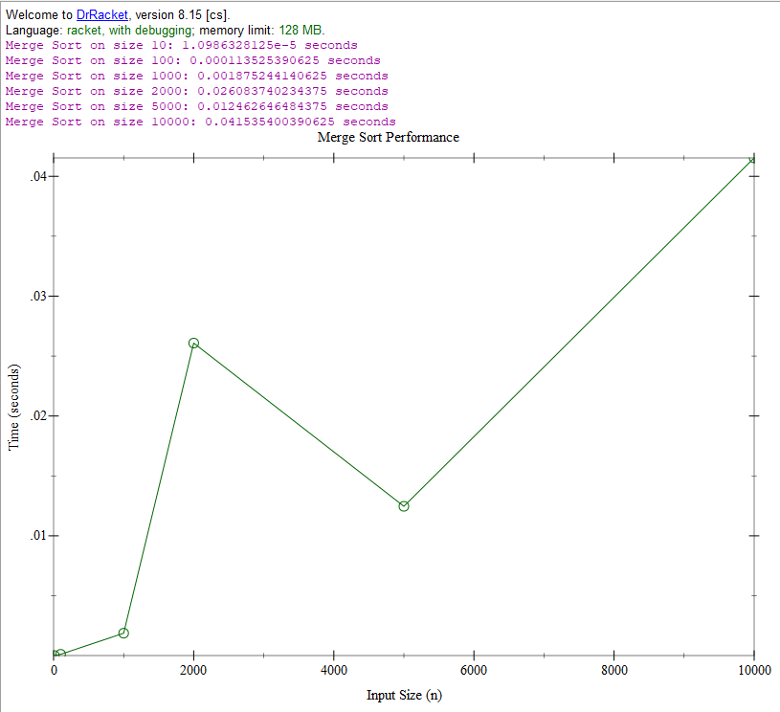
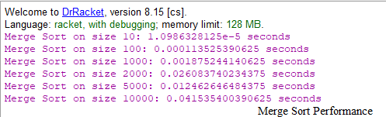
Merge sort Racket
Slower due to list immutability (Cannot be changed after creation)
Higher with list copying
Possible parallelism

Slide 11
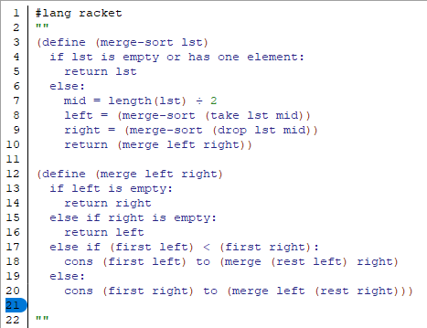
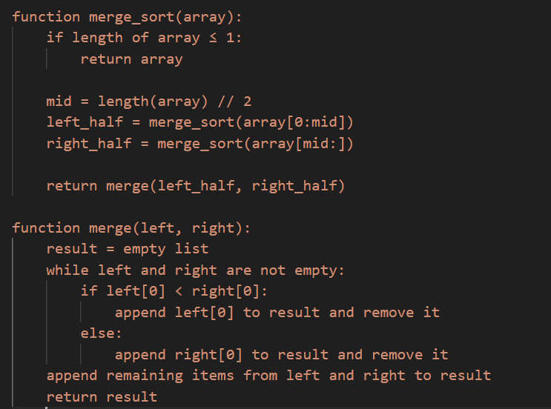
Pseudocode Python vs Racket
Racket
Python

Slide 12
What does this mean for algorithm sorting?
This proves the idea that many different external & internal factors can change the time or speed of an algorithm.
Both Racket and Python ran code for Merge sort, but python was overall the most efficient.
This code was also run on an i7 Laptop vs something with higher computing power.
This also means while comparing algorithms to one another, there will be varying degrees of different results.

Slide 13
What is a Bubble Sort?
A Bubble Sort is a simple algorithm that is used to rearrange values in an array in order of smallest on the left to largest on the right.
The time complexity of a Bubble Sort is O(n^2).
Steps:
Sets the first value in the array as the Max. It then compares it with the number on the right.
If the number it compares to is larger, it sets it as the Max and then moves on to the next value in the array. If not, it flips the numbers around, moving the larger number into the second spot.
It continues until the largest number is “bubbled” to the far right of the array. It then loops around until each number is sorted in its proper place.

Slide 14
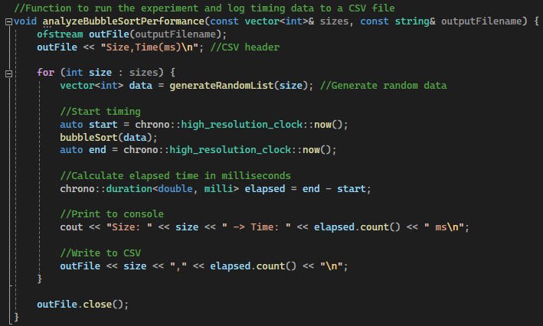
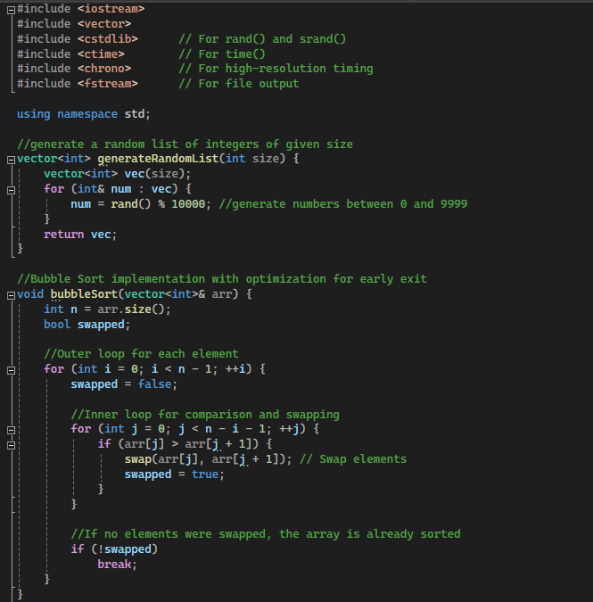
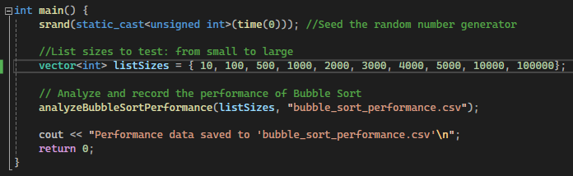
Code for Bubble Sort

Slide 15
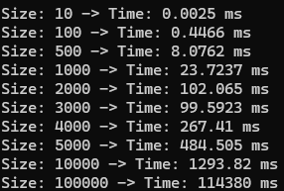
Results for Bubble Sort
Size 10: .0025 ms -> 2.5e^-6 s
Size 100: .4466 ms -> .0004466 s
Size 500: 8.0762 ms -> .0080762 s
Size 1000: 23.7237 ms -> .0237237 s
Size 2000: 102.065 ms -> .102065 s
Size 3000: 99.5923 ms -> .0995923 s
Size 4000: 267.41 ms -> .26741 s
Size 5000: 484.505 ms -> .484505 s
Size 10,000: 1293.82 ms -> 1.29382 s
Size 100,000: 114380 ms -> 114.38 s

Slide 16
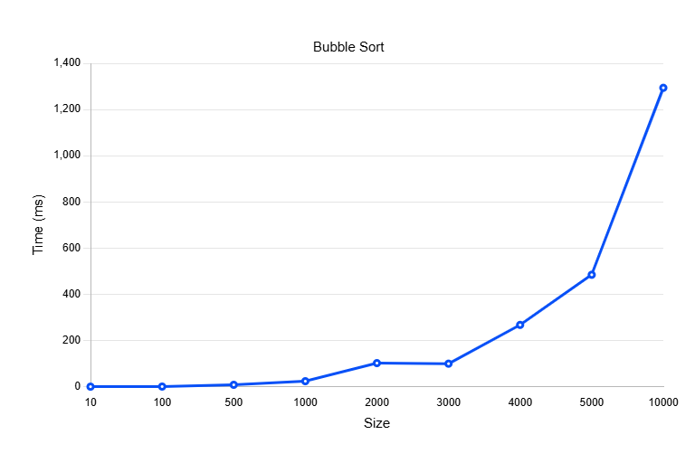
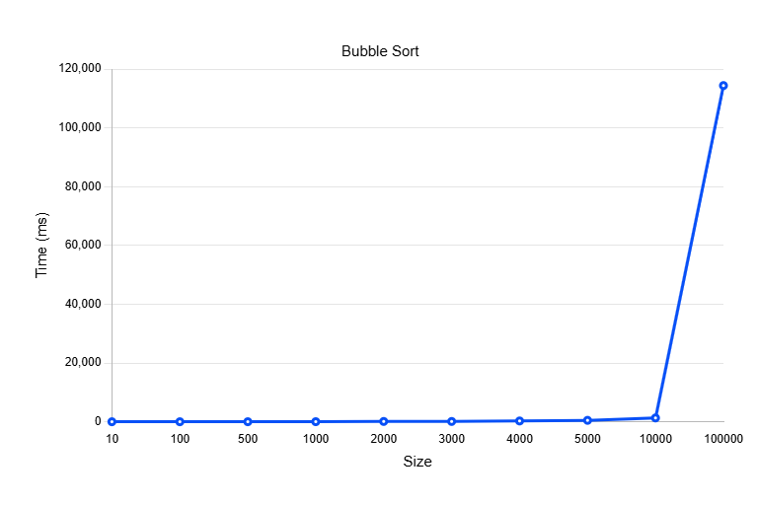
Graph of Time Vs Size (Bubble Sort)

Slide 17
Conclusion
Quick sort was overall the fastest, Merge sort second & then Bubble sort after.
However, Quick sort’s worst case can make it as slow as Bubble sort
Merge sort & Quick sort was much better for large sets of data.
This means Divide & Conquer algorithms tend to do better with larger input sizes.
Bubble sort is good for simplicity and small sets of data
Different environments or external factors can change the speed of these algorithms.

Slide 18

Sources
Wajeb Gharibi, Ph.D. Associate Teaching Professor, Division of Computing, Analytics and Mathematics Introduction to Algorithms & Complexity - SCI-COMP-404.
Geeksforgeeks Merge sort. https://www.geeksforgeeks.org/merge-sort/
ChatGPT (For assistance in generation of code)

Slide 19

Any questions?

